Slide 1
Lecture 5. HTTP Refresher RESTful Web Services

Slide 2
PART I: HTTP Refresher

Slide 3
HTTP Refresher
Hypertext Transfer Protocol
Request-response protocol
Client sends request to server
Server sends response back to client
Supports authentication, caching and use of proxy servers
Makes use of URIs to identify resources
Normally run on top of TCP
HTTPS is HTTP over encrypted connections (SSL or TLS)
Versions 1.1 and 2.0 improve performance (reduce latency, etc.)

Slide 4
HTTP Requests
Messages sent from client to web server via TCP
Request line specifies method:
GET, POST, PUT, DELETE, HEAD, OPTIONS, PATCH, ...
And resource: URI
Request header fields (optional):
For example an Accept field that specifies different “acceptable” content types for the response
Message body (optional)
For example to submit form content in POST requests

Slide 5
HTTP Request Example
POST /examples/rest/bank/transfer/cust1/ HTTP/1.1
Host: localhost:8080
Accept: application/json
Content-Type: application/json
{ "fromAccount":105, "toAccount":100, "amount":50.0}
Notes:
POST is used to send data to a server to create/update a resource.

Slide 6
GET Requests
GET request means: “give me this resource”
GET requests should be preferred choice for queries that do not modify data
GET requests often originate from
typing a URL into a web browser
clicking on a hyper link in a web page
redirecting a web page
submitted forms with method set to GET (e.g. Google)
The URL can encode parameters (“query string”) which are decomposed on the server (“URL rewriting”):
http://www.mysite.org/myservice?fName=Fred&sName=Flintstone
Notes:
GET is used to request data from a specified resource.

Slide 7
POST Requests
POST requests send data
POST requests should be used preferably when you want to create or modify data
They often originate from HTML elements where the method is set to POST:
<FORM action="ProcessServlet" method = "POST"> …
</FORM>
Form values are not visible in the URL
Can send more information than on address line

Slide 8
HTTP Response
Message sent from server to client via the TCP connection on which request was received
Status line with status code and reason message
Response header fields
such as Content-Type: text/html
Empty line
Message body (optional)
Contains the “resource” which has been requested, provided request could be satisfied

Slide 9
HTTP Response Example
Status
Status 200 OK
Headers
Content-Length: 17
Content-Type: application/json
Date: Sat, 05 Aug 2017 16:09:33 GMT
Body
4795.847610355551

Slide 10
Some HTTP Status Codes
2xx Success
200 OK
204 No Content
3xx Redirection
301 Moved Permanently
4xx Client Error
400 Bad Request
401 Unauthorized
404 Not Found
406 Not acceptable
418 I'm a teapot
5xx Server Error
500 Internal Server Error

Slide 11
Media Types and Content Negotiation
HTTP clients can specify the media type they are sending and what media type they expect in the response of the server, see Accept and Content-Type headers in the request example above
Similarly, HTTP servers can specify the media types they can provide for a certain resource and what media types they expect in the request sent by the client
HTTP supports “content negotiation” – selecting the “best” representation for a given response
Some basic media types:
application/json, application/x-www-form-urlencoded
text/plain, text/html, text/css, image/png, …
Please see literature for examples

Slide 12
END OF PART I

Slide 13
PART II: Web Services (Introduction)

Slide 14
Suppose we want to book a trip…
Not sure what airline to use, so we try an online travel agency

Slide 15
lastminute.com

Slide 16
China Airways
Cathay Pacific
lastminute.com
Qatar Airways
Aeroflot

Slide 17
China Airways
Cathay Pacific
lastminute.com
Qatar Airways
Aeroflot

Slide 18
China Airways
Cathay Pacific
lastminute.com
Qatar Airways
Aeroflot
Notes:
Note that the server is providing information about its web services, which describes all the attributes and functionalities of the Web Services.

Slide 19
How did the communication between the agency and the air companies take place?
Database access?
Are all of these websites written in the same language?
Notes:
Note that the server is providing information about its web services, which describes all the attributes and functionalities of the Web Services.

Slide 20
Web Service Introduction
A web service provides some “computational service” for the purpose of machine-to-machine interaction via HTTP(S)
not intended for direct human consumption
Data typically transferred as JSON, XML or text
platform and programming language neutral
Two contrasting approaches
Resource-oriented (“RESTful”)
RPC-style (“remote-procedure call”, SOAP)
We will use a resource-oriented approach in this module

Slide 21
Web Services vs Web Applications
Web Services can be used to transfer data between Web Applications.
Web Services can be accessed from any languages or platform.
A Web Application is meant for humans to read, while a Web Service is meant for computers to read.
Web Application is a complete Application with a Graphical User Interface (GUI), however, web services do not necessarily have a user interface since it is used as a component in an application.
Web Application can be accessed through browsers.
Source: https://www.carmatec.com/blog/web-services-vs-web-applications/

Slide 22
END OF PART II

Slide 23
PART III: RESTful Services
PART A: INTRODUCTION

Slide 24
REST Architecture Style
Approach to client-server applications based around resources (= data) and standard web infrastructure
Resources are identified by URIs
Use standard HTTP verbs to operate on resources, notably
POST, GET, PUT, DELETE
Stateless protocols
No session information is retained by the receiver, e.g. the server
Use of standard content types: JSON, XML, text, ...
Use of web features: HTTP status codes, caching, …
Aims: simplicity, efficiency/scalability, re-use
REST = “Representational State Transfer”

Slide 25
REST Principles: Use of HTTP Verbs
Be disciplined in your choice of HTTP operation
GET should not change resources on the server
For example, GET http://myserver/myresource/delete should NOT delete the resource
POST: create or update
PUT: create or replace at specified URL
PUT and DELETE operations should be idempotent
Repetition of operation should have no further effect
Please see online discussions for “POST” vs “PUT”
Notes:
POST vs PUT: https://www.w3schools.com/tags/ref_httpmethods.asp#:~:text=PUT%20is%20used%20to%20send,that%20PUT%20requests%20are%20idempotent.&text=In%20contrast%2C%20calling%20a%20POST,the%20same%20resource%20multiple%20times.

Slide 26
Web Services using JAX-RS / Jersey
JAX-RS is a Java API specification for “RESTful” web services
It uses annotations (lots!) to define resources and the operations that can be performed on them with injection of request parameters and path-segments
The resource classes can be POJOs (“plain old java objects”)
They do not need to implement any particular interface or extend a particular class
Jersey is an implementation of JAX-RS
We will deploy it on Tomcat launched from a Java program
“embedded Tomcat”
No need for JavaEE or for special web dev support in IDE

Slide 27
HelloServer Example
@Path("/hello")
public class HelloServer {
@GET @Path("/{name}") @Produces(MediaType.TEXT_PLAIN)
public String helloPlain(@PathParam("name") String name) {
return "Hello, " + name + "!";
}
@GET @Produces(MediaType.APPLICATION_JSON)
public String helloJson(@QueryParam("name") String name) {
return "{\"hello\":\"" + name + "\"}";
}
}

Slide 28
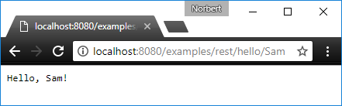
Access in Web Browser

Slide 29
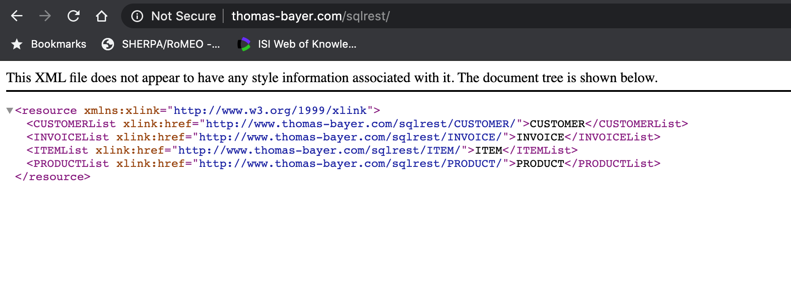
Example of a web service provider (server)
Notes:
We can see the available info this web service can provide: Customer, Invoice, Item, Product. If I put one of these in a GET request, then I’d get the relevant info (see next slide).

Slide 30
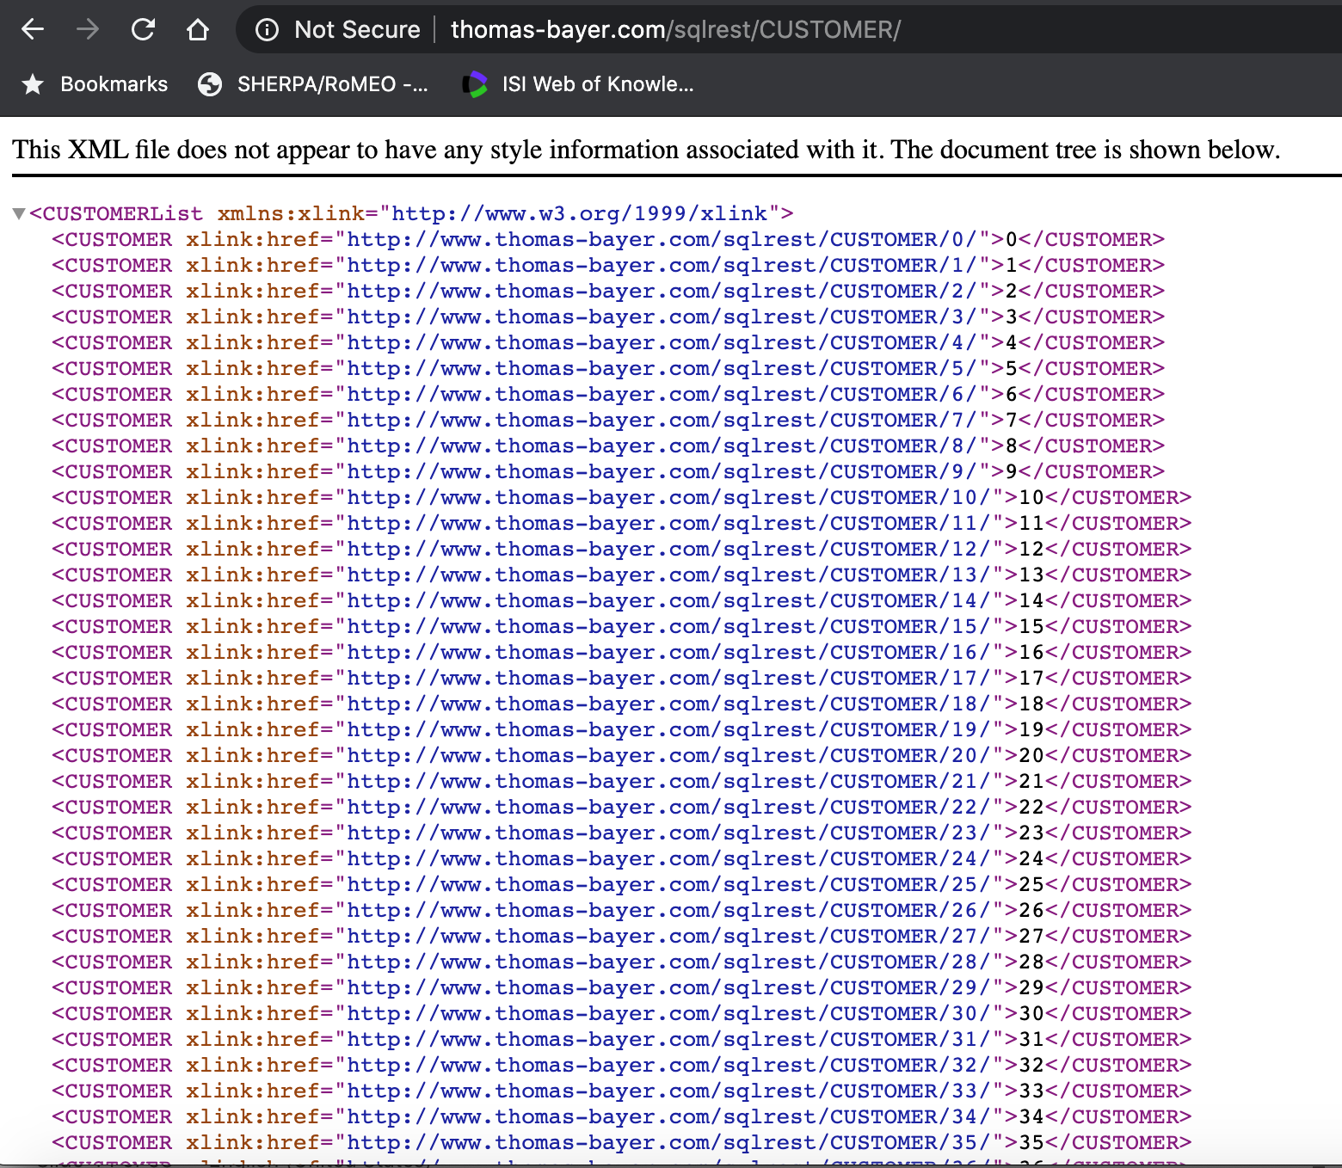

Slide 31
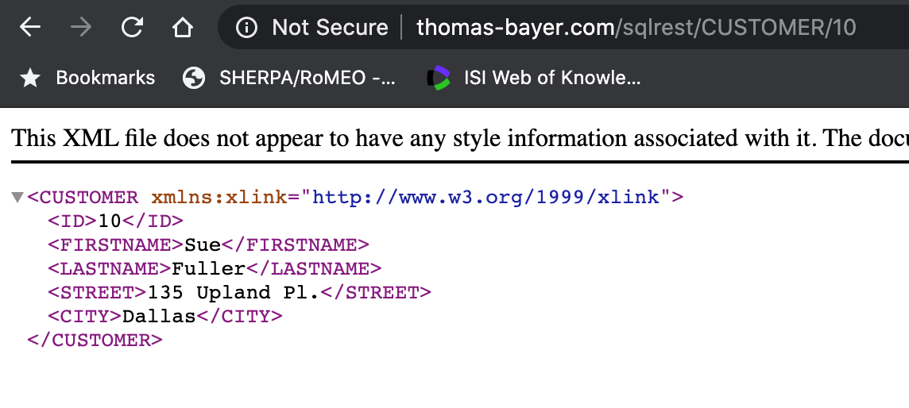

Slide 32
JAX-RS Fundamentals
Resource methods are annotated with a request method designator @GET, @PUT, @POST, or @DELETE
These are the methods which are invoked in response to HTTP requests
@Path annotations determine the mapping from URLs to resource methods
Class level @Path value is prefixed to URL if present

Slide 33
Some Basic JAX-RS Annotations
@Path("/{id}") path parameter declaration
@PathParam("…") path parameter binding
@QueryParam("…") query parameter binding
@FormParam("…") form parameter binding
Content negotiation
@Consumes specifies one or more media types a resource can accept (“consume”) from the client
@Produces specifies one or more media types a resource can “produce” and send back to the client
Notes:
@QueryParam has similar functionality with @PathParam. If you want to retrieve a record based on e.g. id, you can use @PathParam: GET /employee/{id}
However, if you are in a more complicated case, where you want to get the details of all employees but only 10 at a time, then @QueryParam is more appropriate: GET /employee?start=1&size=10
So @QueryParam can be used for filtering.
If @Consumes/Produces is applied at the class level, all the response methods accept the specified MIME types by default. If @Consumes/Produces is applied at the method level, it overrides any @Consumes annotations applied at the class level.

Slide 34
Deployment and Testing
Jersey web services need to be deployed on a web server
Both the web server and Jersey can be configured extensively
Once the server has started, the web services can be accessed via HTTP

Slide 35
PART III: RESTful Services
PART B: Hello WEBSERVICE EXAMPLE

Slide 36
SERVER-SIDE

Slide 37
public class TomcatJerseyServer {
public static final int TOMCAT_PORT = 8080;
public TomcatJerseyServer() {}
public void start() throws ServletException,
LifecycleException {
// JAX-RS (Jersey) configuration
ResourceConfig config = new ResourceConfig();
// Packages where Jersey looks for resource classes
config.packages("bank.rest", "books.rest", "hello");
// Configure Jersey to use Gson
config.register(util.GsonMessageBodyHandler.class);
// Enable logging for debugging purposes
config.property(
LoggingFeature.LOGGING_FEATURE_LOGGER_LEVEL, "INFO");
...
Notes:
This and the next page are the server configuration pages. The main thing you need to focus on here is the config.packages, where you indicate the folders where your files are in.

Slide 38
// Tomcat configuration
Tomcat tomcat = new Tomcat();
tomcat.setPort(TOMCAT_PORT);
// Add web application
Context context = tomcat.addWebapp("/examples", new File("./WebContent").getAbsolutePath());
// Add Jersey servlet
Tomcat.addServlet(context, "jersey", new ServletContainer(config));
// Map certain URLs to Jersey
context.addServletMappingDecoded("/rest/*", "jersey");
// Start server
tomcat.start();
tomcat.getServer().await();
}
public static void main(String[] args) throws Exception {
new TomcatJerseyServer().start(); }
}
Notes:
A servlet is a small Java program that runs within a Web server. Servlets receive and respond to requests from Web clients, usually across HTTP, the HyperText Transfer Protocol.

Slide 39
DEMO
HelloServer.java

Slide 40
END OF SERVER-SIDE EXAMPLE

Slide 41
PART III: RESTful Services
PART B: Hello WEBSERVICE EXAMPLE

Slide 42
CLIENT-SIDE

Slide 43
Clients for RESTful Web Services
Clients need to generate appropriate HTTP requests and parse responses
Web browsers can do this to some extend
but they are not built for this purpose
for example you cannot directly issue a POST request by entering it in the address bar of Chrome
curl is a command line tool for generating HTTP requests
curl -H "Accept: text/plain" http://localhost:8080/examples/rest/hello/Sam
Notes:
Curl examples for the helloServer example:
helloPlain:
Curl http://localhost:8080/examples/rest/hello/Sam
helloJson with queryParam: Curl “http://localhost:8080/examples/rest/hello?name=Sam” [NOTE the double quotes in this example are necessary]
helloPost:
Curl http://localhost:8080/examples/rest/hello -d “Charlie”
helloForm:
Curl http://localhost:8080/examples/rest/form –d “name=Charlie”

Slide 44
Invoking RESTful Services from Java
JAX-RS Jersey also has a Client API
Usage
create a web target pointing at a Web resource
build the request
submit request and process the response
Web target creation includes building a client which may have some configuration such as setting of message handlers and logging levels
Request building may involve construction of entities that are passed in the body, especially for POST and PUT
“Fluent API” with chaining of method calls
See Java code on Moodle

Slide 45
DEMO
HelloClient.java

Slide 46
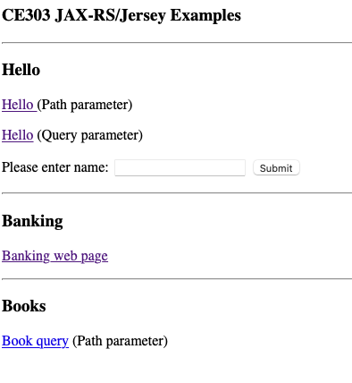
Putting it all together with a web interface

Slide 47
Closing Remarks
RESTful web services have become popular in recent years, especially for “public facing” web services
They are supported in many different programming languages and web application frameworks
JAX-RS / Jersey makes it reasonably straightforward to code web services in Java
Supports programming of both servers and clients
Please see the literature for more details of JAX-RS and Jersey such as the asynchronous client API and server-sent events
Notes:
An asynchronous client constructs an HTTP structure, sends a request, and moves on. In this case, the client is notified when the response arrives. The original thread, or another thread, can then process the response.

